Slide 1

Spend Transaction Processing
Group 4 Final Presentation
Notes:
A good afternoon to our sponsors from Ascenda and prof, we are group 4. Together with my group mates Sheng Qin, Soon Hao, Nicolas, Su Juan and Charmaine, we will be sharing more about our approach to the project.

Slide 2
Content
Project Context (Business needs, Stakeholders, Key use cases)
Solution Demo
Architectural Solution Overview
Solution View
Budget Comparison
Maintainability Design
Availability Design
Security Design
Performance Design
Notes:
For our presentation, we will be running through these few items today. First, let me share our interpretation of the business needs

Slide 3
Business Needs
Stakeholder | Stakeholder Description | Permissions
Ascenda Loyalty | Provides banks with a turn-key solution for a loyalty points processing platform | Read/Write permission to API Gateway Write access to RDS
Banks | Upload customers transaction details daily | Write access to RDS
Customers (Bank users) | View benefits for each eligible transaction | Read permission to CloudFront
Notes:
Here we have listed the business requirements, the stakeholders involved, and the permissions for each stakeholder.
For Ascenda, we will be building an end-to-end solution that process loyalty points for each transaction. For the banks, they will export rows of transaction data that is meant for processing loyalty points and upload it to our system. The customers for the banks will then be able to view the rewards gained from each eligible transaction.

Slide 4
Use Case #1: File Upload & Exclusion Processing
This use case specifies how the client (Ascenda admin) can upload different file sizes on our systems.
Upload transaction and user files
We assume that files can be dragged and dropped into a central dropbox or posted via API (documented in appendix). The process should operate in the background. We expect a file of 1 million records that will be processed by the end of the day. As new customers join the platform and more customers spend more over time, we expect that the file processing will receive files periodically over a day. Thus, files can be asynchronously uploaded.
Convert Currency
If the transaction’s currency is not in SGD, convert to SGD.
Apply exclusion under a card program
All transactions will be first checked against exclusions by using each transaction’s category codes (MCC). Certain spend types will be excluded from the card program.
Notes:
Since our solution requires transaction records, our first use case focuses on the banks and how they can upload their transaction and user files. The banks can drop their transactions and user files of slightly over 1 million rows, which is the maximum on a csv file. We are expecting the files to be uploaded periodically, and these files can be uploaded asynchronously. Once the files are uploaded, there will be an immediate conversion of currency and transactions with certain MCC will be immediately marked as excluded.
For files with invalid or missing data, we have made it such that only that row’s transaction will be skipped.
We will also notify the user if the files uploaded are invalid.

Slide 5
Use Case #2: Campaigns Management
This use case specifies how the client (Ascenda admin) can manage campaign data.
Create Campaigns
The bank merchant managers will create new campaigns by inputting the details of the campaign. If inputs are invalid, an error message will appear.
Apply campaigns
The backend system will compile to see if each transaction under the customer’s card will fulfil a campaign and issue the rewards to the card.
Display/ Update existing campaigns
The campaigns will be displayed and can be dynamically switched on and off.
Notes:
After uploading the transactions, we need to apply campaigns that banks may create from time to time. Banks will need to be able to view campaigns, create campaigns and update the status of each campaign, whether they are active or inactive. Similarly, we also notify users when the campaigns are successfully updated or not.

Slide 6
Use Case #3: Client Transaction View
This use case explains how the bank customers and Ascenda can access a view of all their transactions eligible for rewards.
Input customer ID
The unique customer ID will then be used to identify the transactions they have on all their cards. The transactions are pre-fetched according to the page they are on to reduce the number of API calls.
View transactions
To view more transactions, the next button can be clicked. When accessing previous pages of transactions, there will be no API calls as the transactions have already been called and stored.
Notes:
Finally, credit card users or Ascenda may view the eligible transactions and its corresponding rewards. If an invalid customer ID was entered, the system would return an alert. Otherwise, you can browse through the transactions. One thing to note is that we have implemented pre-fetching in this use case, in which the transactions are sectioned into a customizable number of transactions per page. When page 1 loads, data for page 2 is pre-fetched. When page 2 loads, data for page 3 will be pre-fetched. This way, we would be able to reduce the number of API calls and reduce latency for frequently requested content.

Slide 7
Demo
Notes:
Now let me walk us through the demo

Slide 8
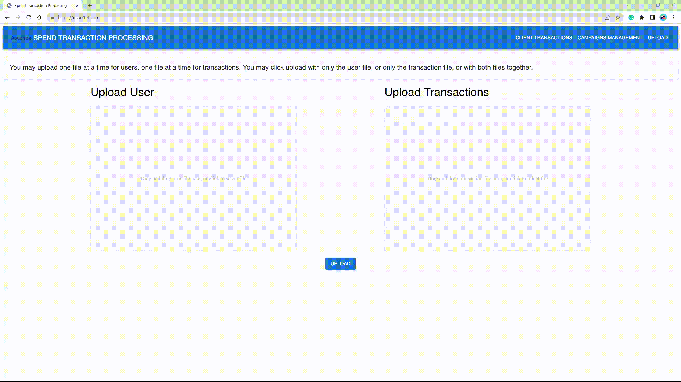
Use Case #1
Notes:
You can select a file from your local computer or drag and drop the file. Then, the file will be uploaded and a success message would appear at the bottom of each box.

Slide 9
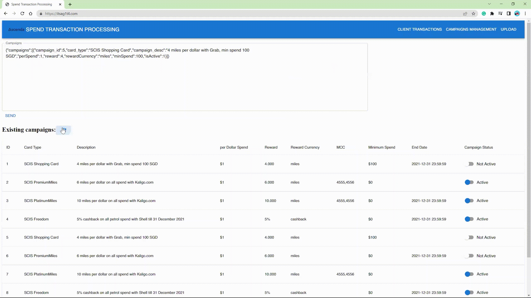
Use Case #2
Notes:
Here we can manage campaigns. So you see, campaign number 5 is currently inactive. To make it active, I will use the pre-filled template here with active = 1. Send the request, and I get back a success message. Now when I refresh the existing campaigns, campaign number 5 would have been reactivated. The text box here actually provides a functioning json template that users can edit to either update an existing campaign or create a new one.

Slide 10
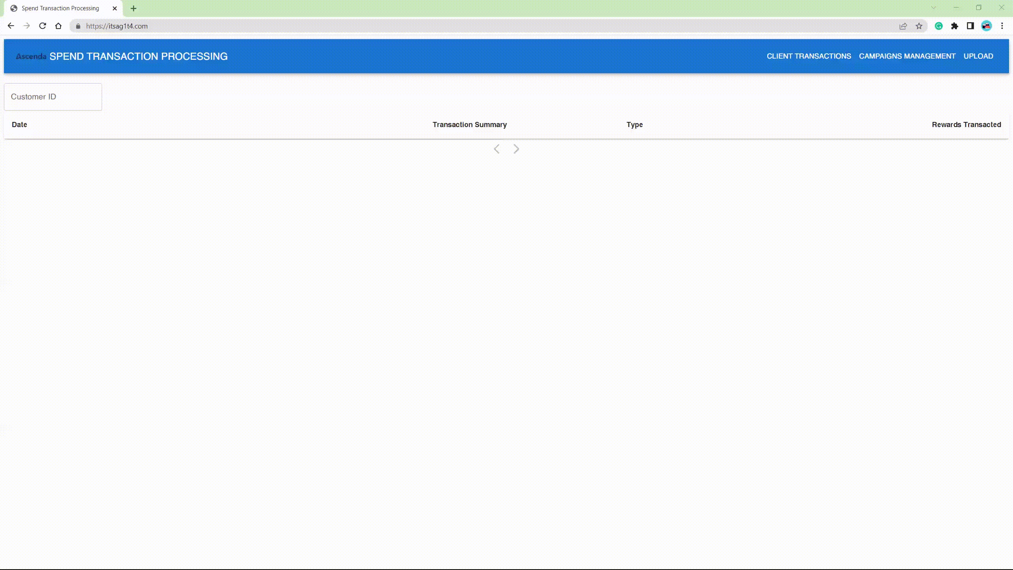
Use Case #3.1
Notes:
This is a case to show that if the customer ID ‘test’ is not available, then an error message like that would appear.

Slide 11
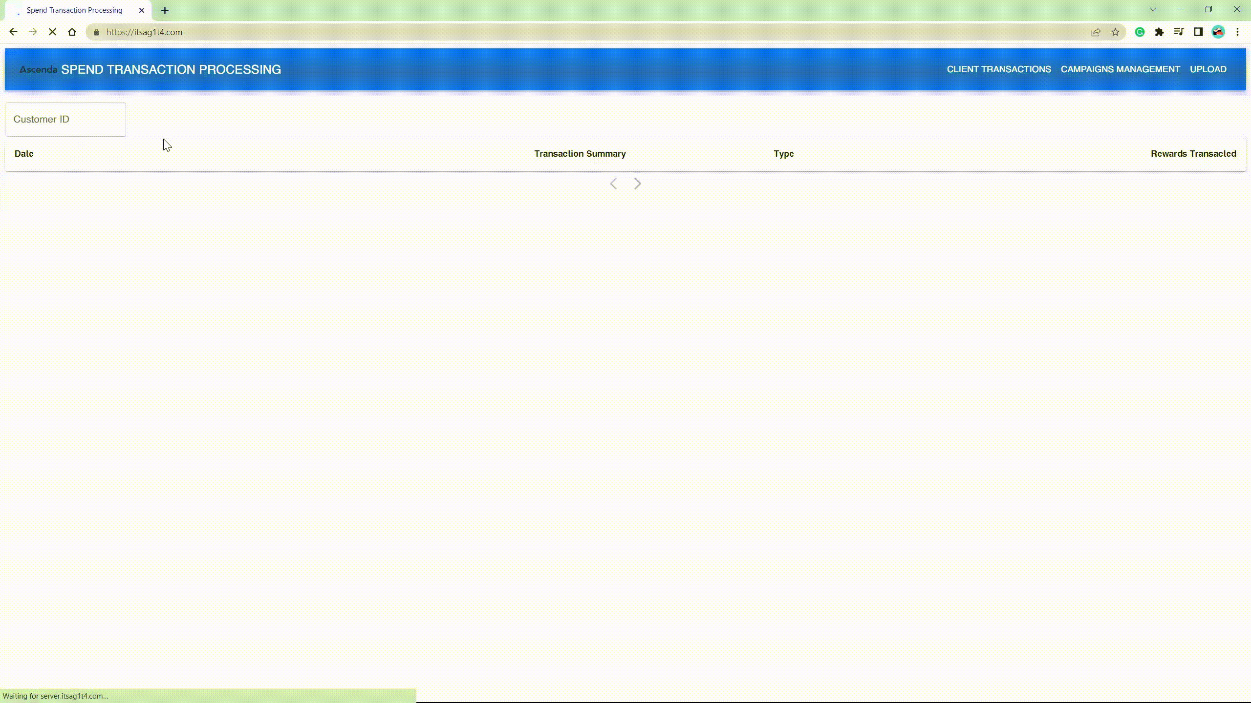
Use Case #3.2
Notes:
And for an existing user, you will see the transactions listed here. Each page has maximum 4 transactions, and the next page is always pre-fetched. When you click the back button, there are no API calls at all because all the data has been retrieved to the end page. So that’s it for our demo, I will pass my time to Su Juan to talk about the architecture solution overview.

Slide 12
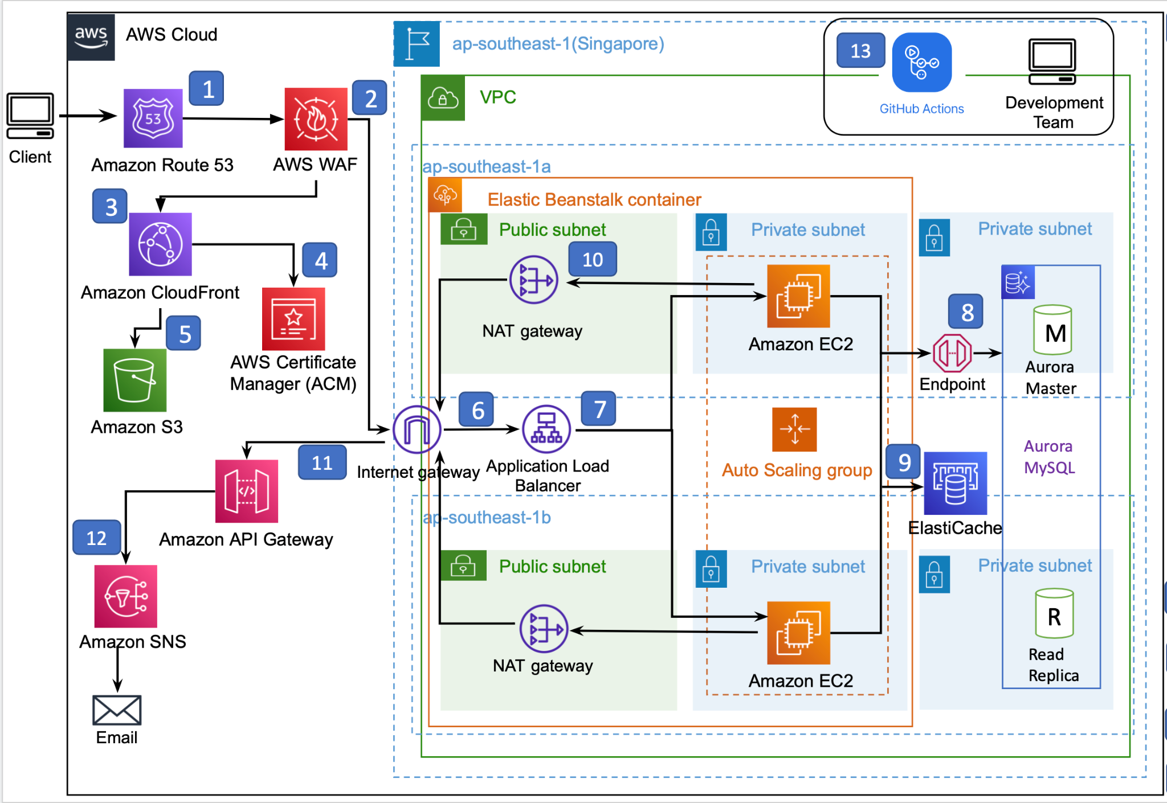
Solution Overview
Notes:
SQ and SJ
Speak about the frontend and backend separately.
Shall we just roughly go through the workflow? Like how to data flow? Since the components will be explained more in the following parts
Do we need to explain why we use each component in this part?
I will roughly go through our solution diagram with you. When client browse the website, route53 will pass the firewall and route the end user to cloudfront and fetch the static webpage from s3.
Any action in the website, request will be sent to the backend server through internet gateway.
Then the application load balancer will distribute the traffic into ec2 in different AZ
EC2 will fetch data from elastic cache if exist else it will read or write the data from aurora database through the endpoint
After request processing in the backend, if there is need to send email notification, request will be send to trigger sns through API gateway

Slide 13
Solution View - Ease of Maintainability
CI/CD with Github Action - Any changes to the frontend and backend application will go through integration testing and automatically deploy to AWS. This would reduce manual work.
AWS Elastic BeanStalk: EBS automatically handles the deployment, from capacity provisioning, load balancing, auto-scaling to application health monitoring.
AWS S3: Hosts the static frontend website that is publicly accessible and maintains bucket versioning, ACL to grant read/write permissions and provides metrics for analysis purposes
Notes:
We have made our solution easy to maintain through these 3 main steps.
Firstly, we implements CI/CD with Github Action to automatically test and deploy any changes pushed to the frontend and backend repositories.
Secondly, we use AWS Elastic BeanStalk to handle capacity provisioning, load balancing, auto-scaling and health monitoring.
Lastly, AWS S3 helps to host the static frontend website for anyone to access, with ACL read/write premissions granted to specific users, such as banks and Ascenda accounts.

Slide 14
Solution View - Integration Endpoints
Source System | Destination System | Protocol | Format | Communication Mode
Python Flask | React | HTTPS | JSON | Asynchronous
Web Browser | Route 53 | HTTPS | JSON | Synchronous
Route53 | CloudFront | HTTPS | JSON | Synchronous
CloudFront | S3 | HTTPS | JSON | Synchronous
API Gateway | AWS SNS | HTTPS | JSON | Asynchronous
Aurora | Read replica | HTTPS | MySQL | Asynchronous
Aurora | Write | HTTPS | MySQL | Asynchronous
AWS SNS | Email subscriber | HTTPS | JSON | Asynchronous
Notes:
These are the integration endpoints, and they all follow the protocol, format and communication mode as shown.

Slide 15
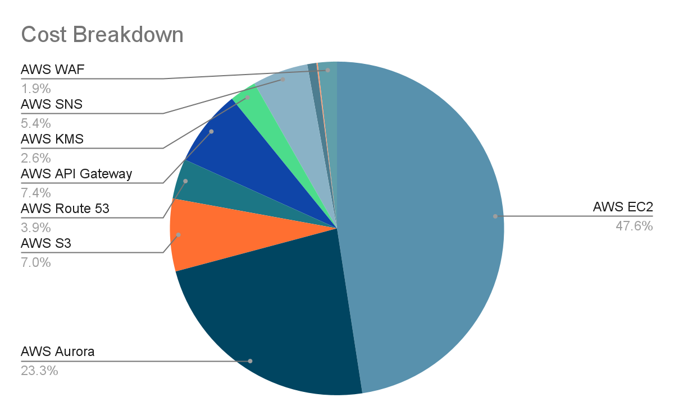
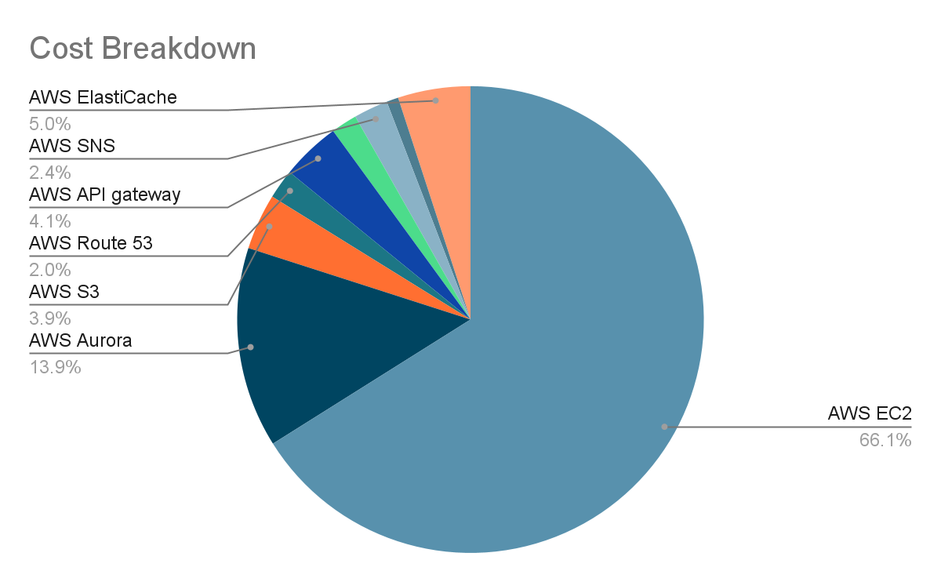
Budget Comparison
Proposed Total Cost: ~ 268.92 USD/ month
Actual Total Cost: ~ 610.11USD/ month
Notes:
Then its the cost overall view
Here are the 2 pie chart for proposed and actually cost breakdown
The actual total cost is
The proposed total cost is
EC2 and aurora are still the 2 main components in budget

Slide 16
Main Differences
Services | Description | Final Cost | Proposed Cost
AWS EC2 | 2 x t2.2xlarge* instances with VPC and ALB in 2 different AZs | ~402.13 USD/month | ~128.41USD/month
AWS Aurora MySQL- serverless | 1 ACU with 80 GB database storage and backup storage | ~84.61 USD/month | ~62.41 USD/month
AWS S3 | S3 Standard 20GB/month, S3 Glacier 5TB/month | ~23.65 USD/month | ~18.99 USD/month
AWS ElastiCache | 1 standard node, reserved for 1 year, t2.medium cache | ~30.66 USD/month | NA
AWS Codepipeline & Codebuild & Codedeploy | - | NA | ~5 USD/month
Notes:
For ec2, we changed the instance type from t2.micro to t2.large for higher performance and faster file processing.
For data storage, we changed to use serverless Aurora mysql
S3 will cost slightly higher due to the region change
We added elasticache which will cost 30.66 USD/month

Slide 17
Maintainability Design

Slide 18
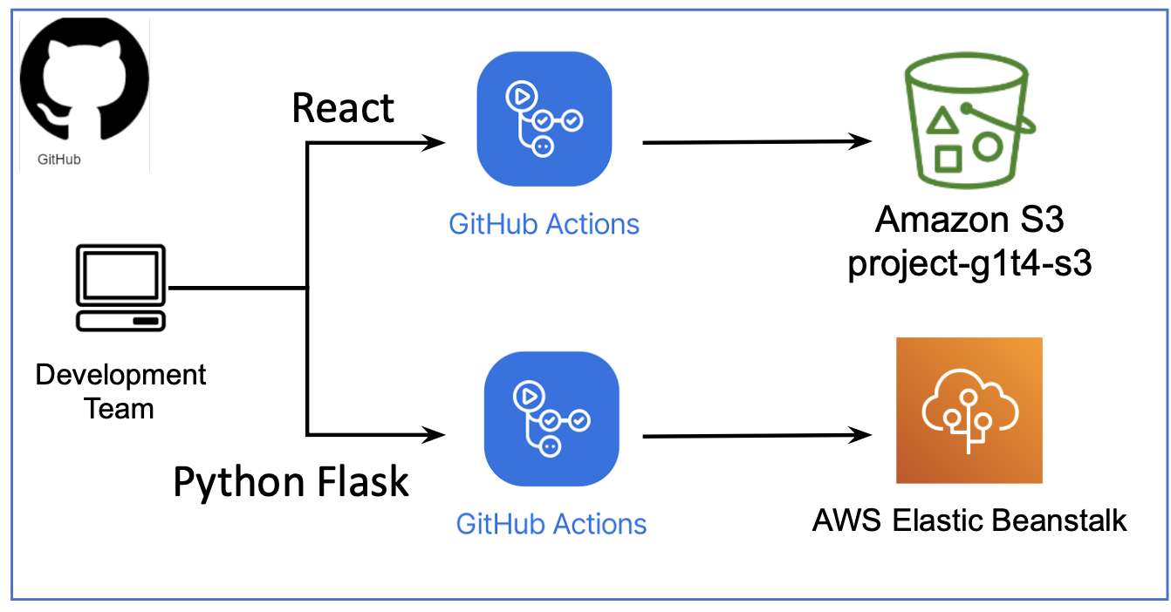
Development Pipeline (CI/CD)
Cypress used for end–to-end testing
Pytest used for function unit testing
Email notification to developer if any failure action e.g testing, deployment
Notes:
We created 2 repositories, one for the frontend website (React) and another for the backend server (Python Flask). Each repo contain an automated GitHub workflow. Once the code changes are made in the respective application folder and pushed to the main branch, workflow will be triggered and application will be tested and deployed to s3/ebs automatically . The Deployment step can only be executed when all the test cases are passed.
For frontend react application, we use cypress for end-to-end testing and for backend flask application, we use pytest for unit testing.
If there is any failure action, github will send email notification to the developers.
Using these continuous integration, deployment and testing, it will ensure a higher maintainability as the development pipeline can be accelerated. Also, bugs in the application can be caught early by the automated test cases before they become bigger problems in the future.

Slide 19
Availability Design

Slide 20
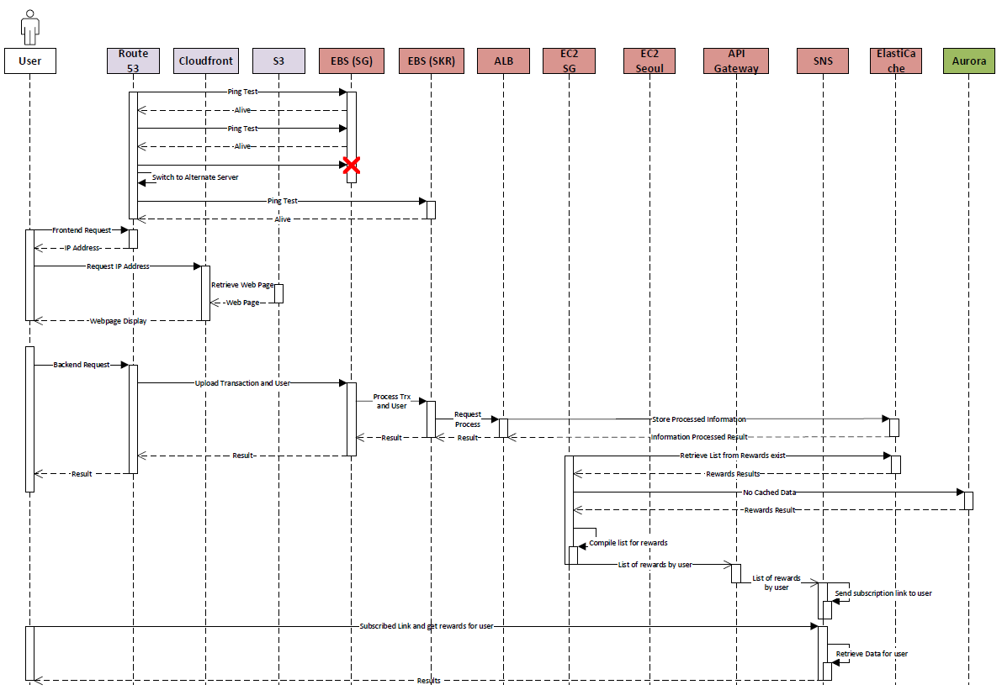
Notes:
In the sequence diagram, we have noted some of the changes to be made from the proposal/ Please do ignore the box for the user, by right there should not be a box but Visio’s template is like that, Microsoft Products.
Nonetheless, we do understand that there are 3 use cases. We can also see 3 different sections in terms of the component’s categories, which are the frontend in purple color, server components in dark brown color and the DB component in green color.
The first activation line in the user will consist front end request where the user will be able to retrieve the web page as shown in the demo. The second activation line in the user will trigger the backend requests that requires more processing to be done from the server side and perhaps interaction with the database. Now for the third activation line is someone special because it is not triggered by the user but triggered by the EC2 instance upon the detection the date and process the compilation of the rewards, send the link of the rewards to the user and finally the user will only be involved once he clicks on the link to subscribe to the notification to get the rewards points reflected on their device.

Slide 21
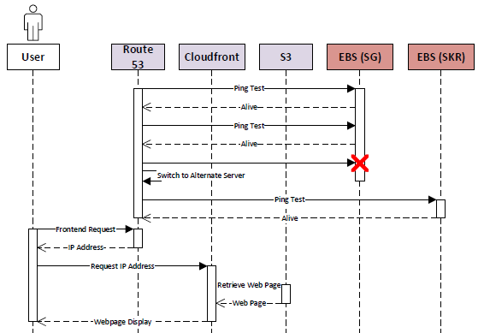
Notes:
In the sequence diagram, we have noted some of the changes to be made from the proposal/ Please do ignore the box for the user, by right there should not be a box but Visio’s template is like that, Microsoft Products.
Nonetheless, we do understand that there are 3 use cases. We can also see 3 different sections in terms of the component’s categories, which are the frontend in purple color, server components in dark brown color and the DB component in green color.
The first activation line in the user will consist front end request where the user will be able to retrieve the web page as shown in the demo. The second activation line in the user will trigger the backend requests that requires more processing to be done from the server side and perhaps interaction with the database. Now for the third activation line is someone special because it is not triggered by the user but triggered by the EC2 instance upon the detection the date and process the compilation of the rewards, send the link of the rewards to the user and finally the user will only be involved once he clicks on the link to subscribe to the notification to get the rewards points reflected on their device.

Slide 22
Notes:
In the sequence diagram, we have noted some of the changes to be made from the proposal/ Please do ignore the box for the user, by right there should not be a box but Visio’s template is like that, Microsoft Products.
Nonetheless, we do understand that there are 3 use cases. We can also see 3 different sections in terms of the component’s categories, which are the frontend in purple color, server components in dark brown color and the DB component in green color.
The first activation line in the user will consist front end request where the user will be able to retrieve the web page as shown in the demo. The second activation line in the user will trigger the backend requests that requires more processing to be done from the server side and perhaps interaction with the database. Now for the third activation line is someone special because it is not triggered by the user but triggered by the EC2 instance upon the detection the date and process the compilation of the rewards, send the link of the rewards to the user and finally the user will only be involved once he clicks on the link to subscribe to the notification to get the rewards points reflected on their device.

Slide 23
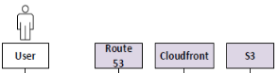
Frontend Components (Availability)
Users are redirected by Route53 to CloudFront.
Cloudfront will retrieve web page display from S3 and will display to user.
Cached and High Availability.
Notes:
Over here, we can see that users are redirected by Route53 to cloudfront. The reason we made this change is because we want to have make the availability higher for users. Cloudfront helps us to do that because the frontend web page is cached and served to the users. Route53 DNS with the cloudfront distribution uses CNAME records distribution to service static websites from S3 that uses only low network latency and high transfer speeds.
The frontend website with Route53 domain name services with CloudFront distribution using CNAME records distribution to service static websites from S3 with low network latency and high transfer speeds. With this set up, The Frontend web page is cached and served with CloudFront with all edge locations to provide high availability for users.

Slide 24
Server Components (Availability)
Elastic Beanstalk environments (Managed Service)
Ap-southeast-1
Ap-northeast-2
Distributes traffic to minimally two availability zones
Auto Scaling of EC2 Instances
Routing with Application Load Balancer
Health Monitoring in the event of failure
Recommendations:
ElastiCache (Redis) configured for high availability
Multi-AZ
Automatically fails over to replicas
Notes:
Soon Hao
Send subscription link

Slide 25
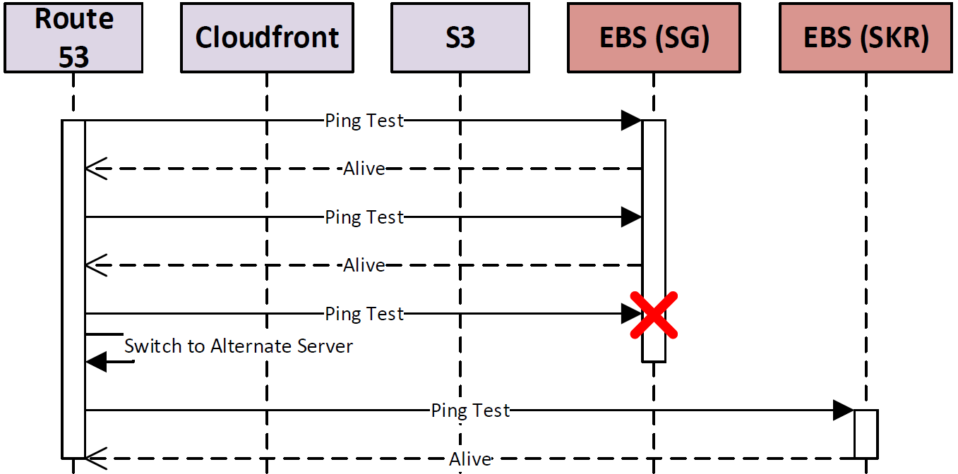
Regional Failover
Ap-southeast-1 (Singapore)
Primary Region
Ap-northeast-2 (Seoul)
Secondary Region
Route53 (DNS Service)
Health Checks to monitor Elastic Beanstalk
Failover to secondary region by routing traffic

Slide 26
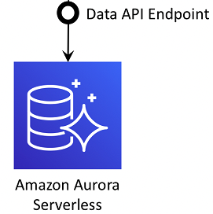

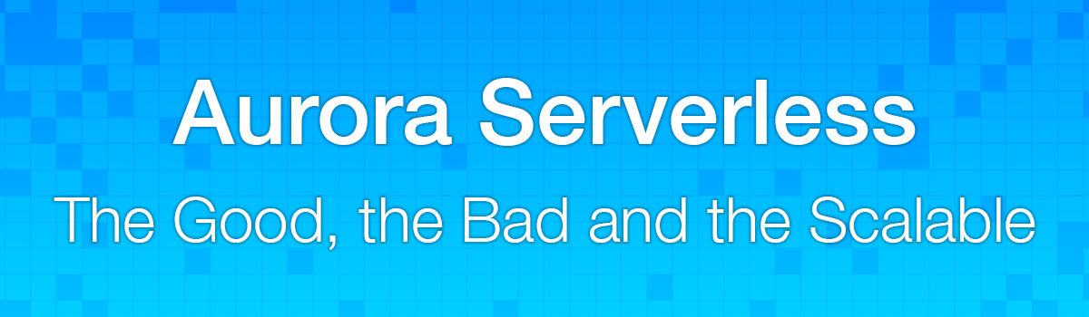
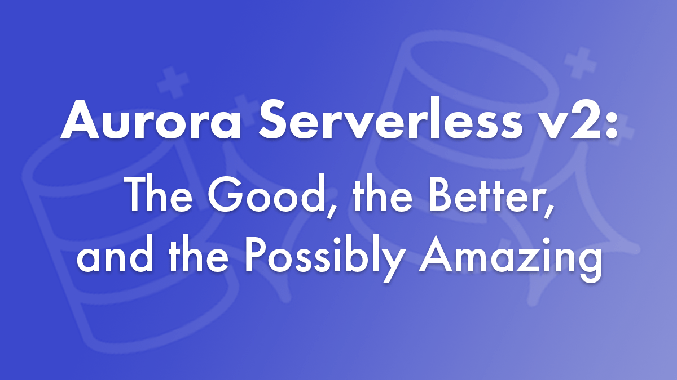
Database Components (Availability)
Fully Managed Service Designed for speed, availability and scalability
High Availability achieved through Global Database
Auto-scaling
Distributed
Fault-tolerant
Self-healing system
Implemented both Aurora & Serverless
Recommendations: Serverless v2
AWS Backup In unlikely event of downtime
Notes:
Aurora is a fully managed database that is designed for speed, availability and scalability of high-end databases with the simplicity and cost of open source databases. Aurora provides a distributed, fault-tolerant and self-healing system that is decoupled from compute resources & auto scaled up to 128TB per database instance on demand.
The downside to this was the immense cost that comes with it as Aurora (Server) cost 300% more than traditional MySQL databases and 20% more than RDS however this is circumvented by using Aurora Serverless.
The implemented solution uses AWS Aurora Serverless that is suitable for transactions for unpredictable spikes in workloads such as uploading large amounts of data. Aurora Serverless is configured with auto-scaling set to a minimum instance when usage for the database is low for example in the solution view, the minimum instance is set to 1 while the maximum instance is currently set at 10. This provides charge on on demand usage, auto-scaling, and high-availability.
The solution uses a MySQL database on Aurora Serverless The solution prioritises data consistency & integrity over a non-relational database such as DynamoDB. Using a non-relational database such as DynamoDB and using Dynamo transactions to provide ACID properties to transactional data requires additional complexity to the solution. Additionally, AWS Backup is used to ensure data is backed up (currently set to monthly) in the unlikely event of downtime since it is a fully managed serverless solution.

Slide 27
Security Design
Notes:
Charmaine

Slide 28
Confidentiality
Potential Threat: Packet Sniffing
Packets sent via HTTP are not encrypted; Attackers can easily sniff for sensitive data transmitted in these packets.
Assets: Amazon S3, Amazon EC2
Mitigation: Using HTTPS protocol for automatic encryption of network packets to thwart sniffing attacks

Slide 29
Confidentiality
Potential Threat: SSL Strip
SSL stripping allows attackers to force a unencrypted response from the server by hijacking packets and sending them to its respective HTTP endpoint. As packets sent over HTTP are not encrypted, sensitive data can be leaked this way.
Assets: Amazon S3, Amazon EC2
Mitigation: Automatic HTTPS redirection forces all connections to the server to only be HTTPS connections. Since data transmitted through HTTPS is encrypted by default, attackers will not be able to view the data being transmitted.

Slide 30
Availability
Potential Threat: Distributed Denial of Service (DDoS)
As the API gateway is exposed to the internet, attackers can flood the endpoints with request to overload the servers, causing a denial of service.
Assets: Amazon S3
Mitigation: AWS Shield provides always-on detection and automatic inline mitigations against DDoS attacks.

Slide 31
Authenticity
Potential Threat: SQL Injection
Allowing SQL injection attacks will leave the database vulnerable to unauthorised access. Attackers who do not have the credentials to the database are able to view and even modify the data in the database using this attack.
Assets: Amazon S3
Mitigation: AWS WAF protects against SQL injection attacks by using SQL injection match conditions. If a request contains malicious SQL code, the request will be automatically blocked.

Slide 32
Authenticity
Potential Threat: Unauthorised access
Without the use of API keys or implementing proper access controls, any unauthorised individual will be able to access and modify the data stored in the database through the unprotected API endpoints.
Assets: Amazon S3
Mitigation: Configuring Security Groups, Access Control Lists in AWS and using API Keys will allow only authorised users to access and modify the data retrieved from the API.

Slide 33
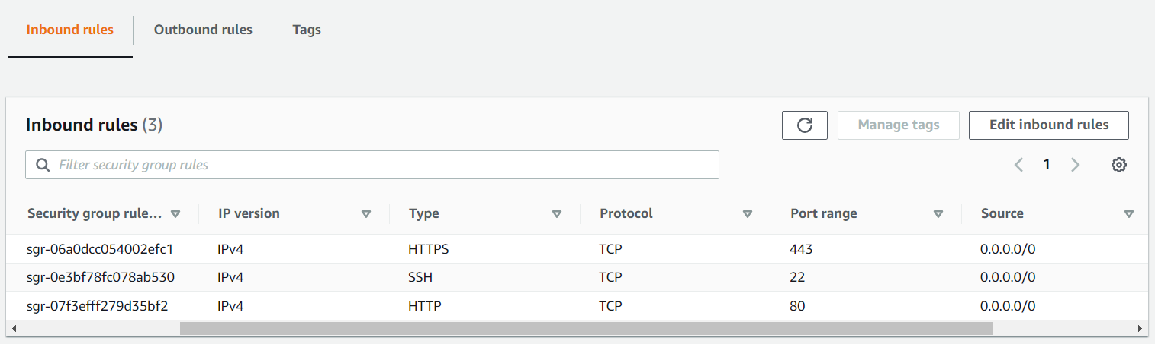
Security View
Security Groups
Inbound

Slide 34
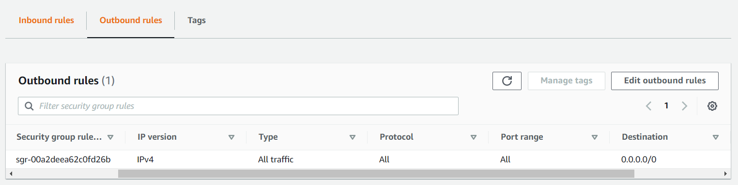
Security View
Security Groups
Outbound

Slide 35
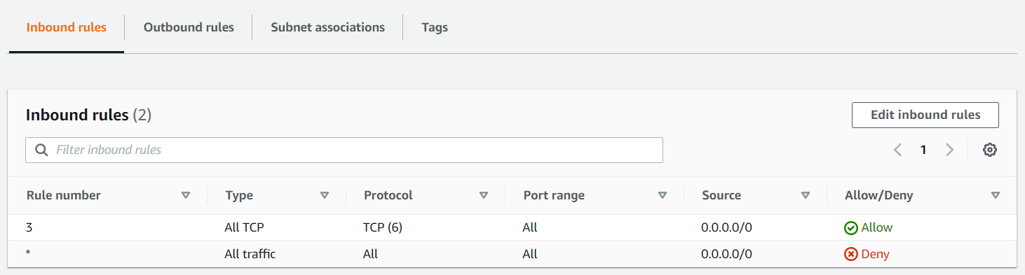
Security View
Access Control List
Inbound

Slide 36
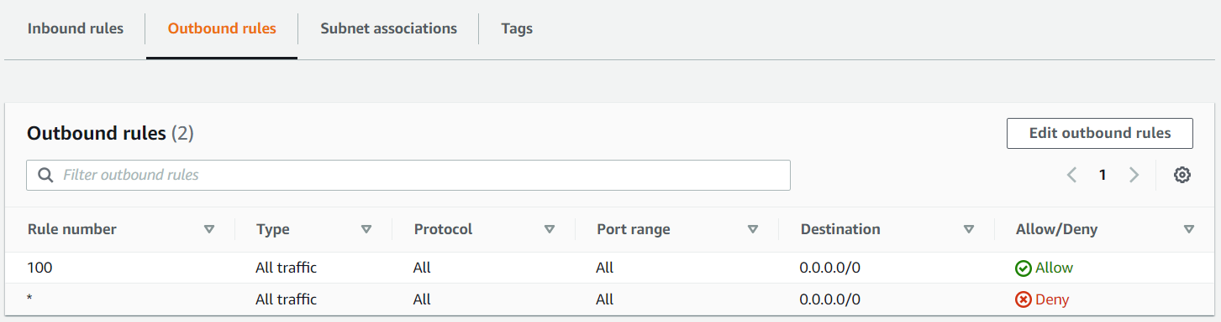
Security View
Access Control List
Outbound

Slide 37
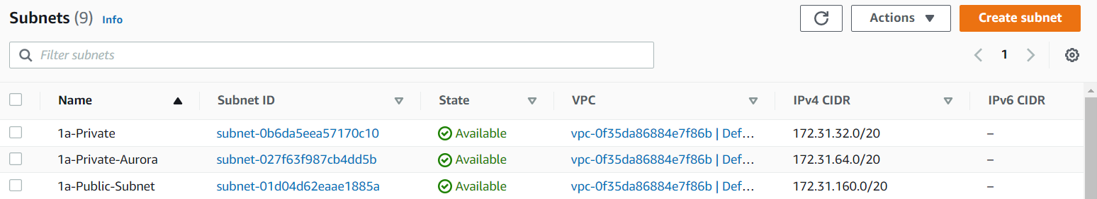
Security View
Subnet Configuration
Subnets

Slide 38
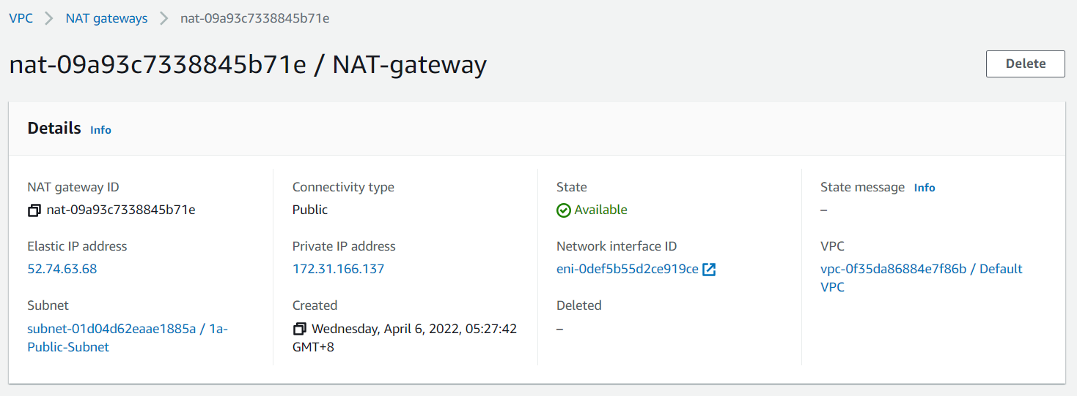
Security View
Subnet Configuration
NAT Gateway

Slide 39
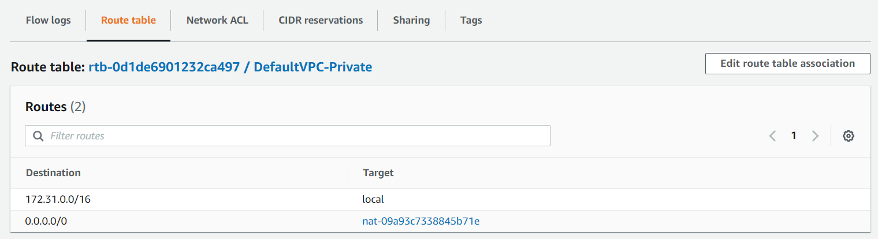
Security View
Subnet Configuration
Private Subnet

Slide 40
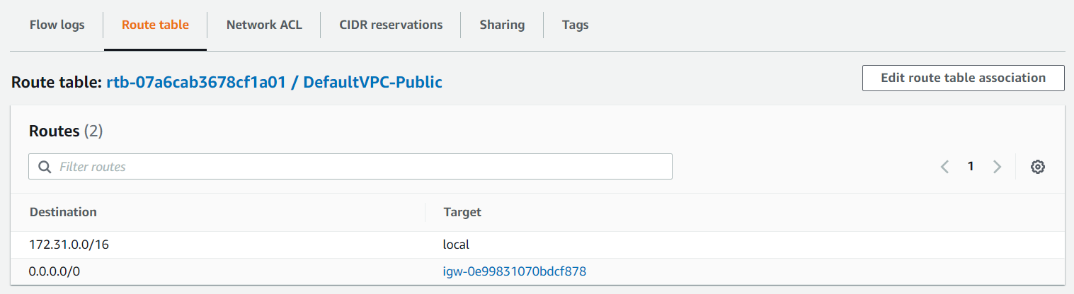
Security View
Subnet Configuration
Public Subnet

Slide 41
Performance Design
Notes:
Sheng Qin
[10:00 min]
Now, I will be presenting on the performance section

Slide 42

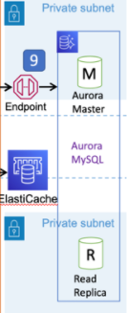
Performance - Aurora Read Replicas
AWS Aurora Read Replica
Requests like view card transaction and campaign management are highly performant, especially during peak periods
Read replicas can help to serve these requests, achieving
horizontal scaling and improving performance
Notes:
Requests like view card transaction and campaign management are highly performant, especially during peak periods. Read replicas can help to serve these requests, achieving horizontal scaling and improving performance

Slide 43

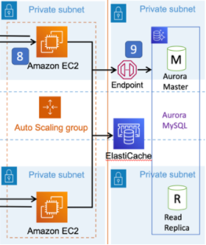
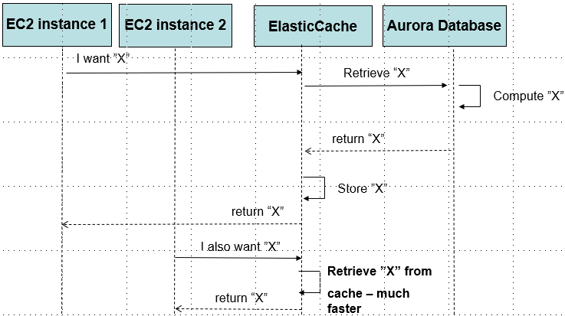
Performance - Caching
AWS ElastiCache
Caching is used for server api endpoints using AWS ElastiCache
Retrieve from cache instead of the server for repeated requests for the same set of data
Reduce number of calls to server and database
Improves performance, especially during periods of large requests
Notes:
For repeated requests of the same set of data, the result can be retrieved from the cache instead of the server. This reduces the number of calls to the server and the database. This improves their performance, especially during periods with a large number of requests

Slide 44

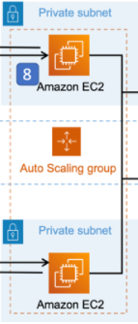
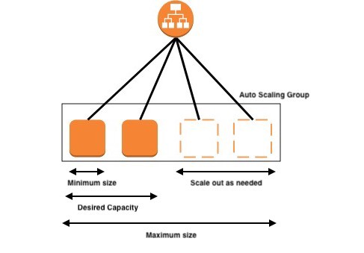
Performance - EC2 autoscaling
AWS Auto Scaling Group
Elastic Load Balancing scales application load balancer to match the changing traffic to our website over time
Load balancer automatically register new instances using auto-scaling to handle an increased number of requests
Notes:
Elastic Load Balancing scales the application load balancer to match the changing traffic to our website over time. It is able to scale to the vast majority of workloads automatically.
For instance, during periods where there are many requests to the server, the load balancer will automatically register new instances using auto-scaling to handle an increased number of requests.

Slide 45
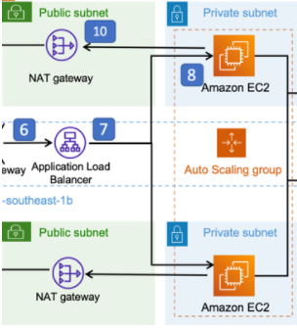
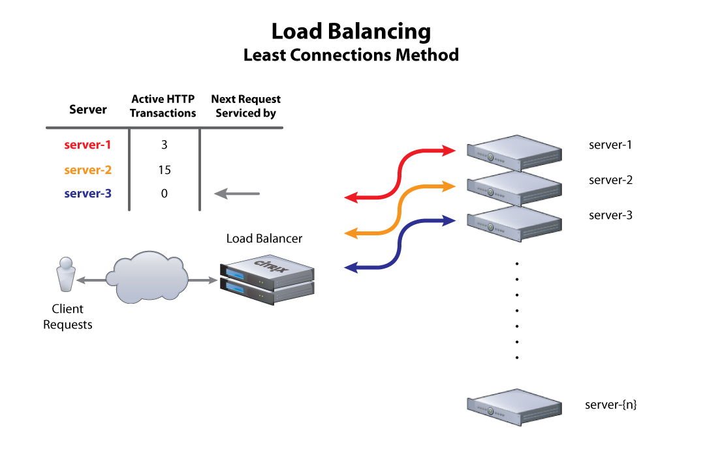

Performance - Least outstanding requests routing
Requests for our website vary in complexity
Load balancer route requests to target with least outstanding requests
Targets processing long requests are not burdened with more requests
Load is evenly spread across targets
AWS Application Load Balancer
Notes:
We chose to use the least outstanding requests routing algorithm over the default round-robin algorithm as the requests for our website vary in complexity. For example, the requests to process the transactions and users' files will take a significantly longer time than simply requesting the processed records. Using this algorithm, as new requests arrive, the load balancer will route them to the target with the least number of outstanding requests. Targets processing long-standing requests are not burdened with more requests and the load is evenly spread across targets.

Slide 46
Performance - Parallel transactions
User file and transactions file can be uploaded and processed using parallel execution
They do not have dependencies on each other
Saves a substantial amount of time as it usually takes around 5 mins to upload each file
Notes:
The user file and transaction file do not have dependencies on each other so they can be uploaded simultaneously and processed using parallel execution. This saves a substantial amount of time as it usually takes around 5 mins to upload each file.

Slide 47
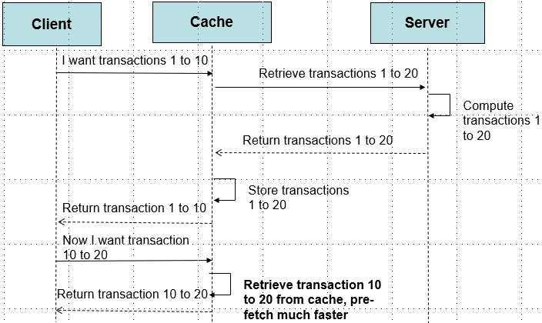
Performance - Pre-fetch
When users retrieve 10 transactions, server will pre-fetch 20 transactions
Users can go to next page without waiting for another request to the server
Increases speed of viewing the transactions
Reduce number of calls to server and
increase the performance
Notes:
This increases the speed of viewing the transactions as users can immediately go to the next page without waiting for another request to the server

Slide 48
Thank you
Group 4

Slide 49
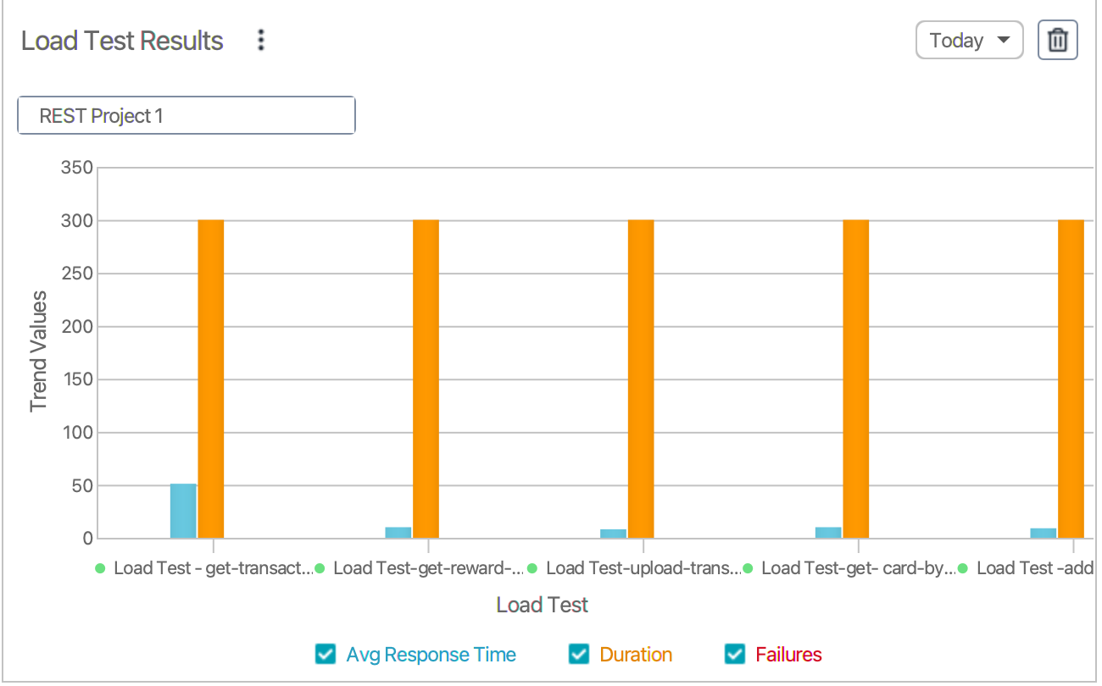
Load Testing
Test | No.of virtual user per second | Average response time
Get transaction by user id | 1000 | 51ms
Get reward by user id | 1000 | 10ms
Upload transaction/ user File (1 million rows) | 500 | 580,000 ms (9 min 40s)
Get card by user id | 1000 | 10ms
Add transaction | 500 | 9ms

